Slide 1
GPU Forecast and Analysis
Tyler Anderson
Notes:
Hello My name is Tyler Anderson, and this is my project on Graphics Processing Units or GPUs

Slide 2


Graphics Processing Unit (GPU)
Notes:
This project will discuss the Graphics Processing Unit (GPU) performance over time as well as predict what the performance of GPUs in the year 2030. But first we need to know what a Graphics Processing Unit (GPU) is. A GPU is a silicone-based microprocessor that handles small amount of tasks but can do it very quickly. For example, A CPU is like a truck, it can handle multiple tasks like spreadsheets, chrome browsers, media and more. GPUs are like sports cars they are very fast but can only handle a few tasks. GPUs handle computations in parallel, this focused speed specialization of the GPU is why GPUs are popular among gamers, it can handle multiple computations for computer graphics. GPUs have gotten fast enough that they are being used for Machine Learning in the field of data science.

Slide 3

GPU Forecast
Notes:
I want to see if the competitive nature of the graphics card market pushes past Moors law or if Moors law is a limiting factor in the development of new Graphics Cards. To predict the performance of graphics cards in 2030 I will need to use regression models to get a good estimate. In order to focus on performance of GPUs I will need to specifically focus o 3 parameters. Core speed [MHz], Memory Bandwidth [GB/sec] and Memory size [MB or GB].
This dataset contains two CSV files: gpus.csv for Graphics Processing Units (GPUs), and cpus.csv for Central Processing Units (CPUs), for this project I will only be using the GPU dataset. Each table has its own list of unique entries, but the list of features includes clock speeds, maximum temperatures, display resolutions, power draws, number of threads, release dates, release prices, die size, virtualization support, and many other similar fields. With moors law stating the number of transistors in a dense integrated circuit (IC) doubles about every two years. I want to see how the memory size of these GPUs changes over time. I plan to see how moors law effects GPU releases and if in the year 2030 GPU memory capacity will change in line with moors law. I also want to analyze how performance over ratio evolve over time. How is the general computing power different? And are there any manufacturers that are known for some specific range of performance & price? I hope to see some interesting results here as NVidias new GPU line in 2020 has had impressive performance boosts and a reduction in costs from last generation.

Slide 4
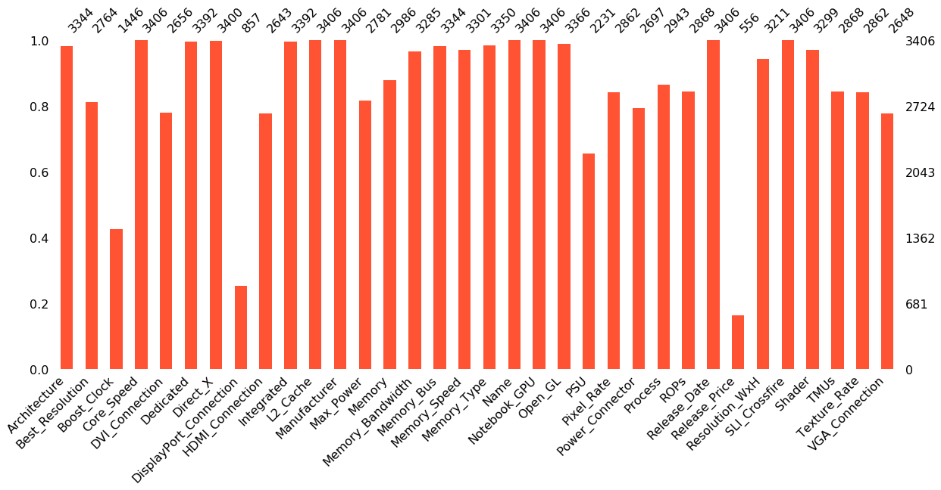
Analysis
Missing Values found
Missingno package
Notes:
My first step was to investigate the data and see of there was anything that stood out to me. Right away we can see that there is lots of undefined values. I used the “Missingno" package which is a useful and convenient tool in visualizing missing values in the dataset. There are only few columns that can by use as reliable source of information for our analysis. Most of columns are incomplete or in wrong format. We will perform data preprocessing to make some columns useful in our analysis.
Based on our research and our main hypothesis for this project the columns we select will indicate the key data for our project. After selecting the data, we can use data preprocessing and feature engineering to process our columns into something we can use later on in the project.

Slide 5
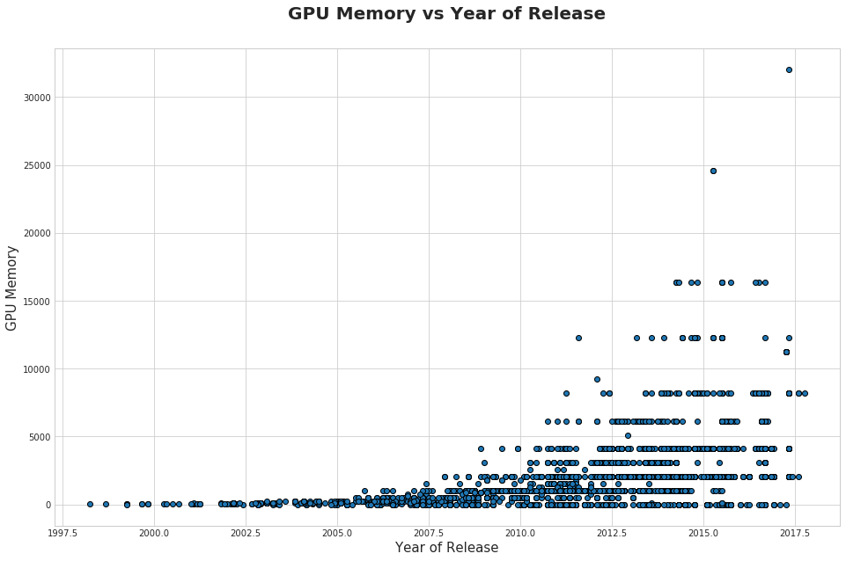
GPU Memory
GPU performance increased dramatically since 2010
Notes:
We can also look at some visualizations to take a look at GPU memory to see how much the competition has increased over the last 10 years and how much improvement in GPU performance has been made since 2010.
We can clearly see that since 2010 GPU performance has increased dramatically possibly due to increased competition or Moors law dictating the GPU performance. We can now calculate mean and median Memory Size of GPU for each year and create line plots to visualize the upward trend.

Slide 6
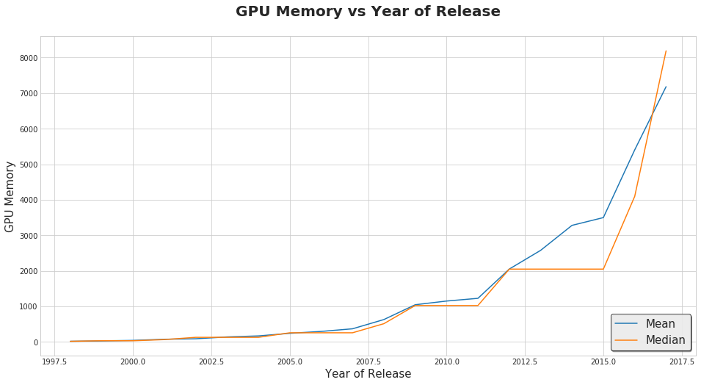
GPU Memory
We can see the mean and median GPU memory are in line with each other with the exception of 2015.
Notes:
We can see the mean and median GPU memory are in line with each other with the exception of 2015.
In 2015 AMD and Nvidia have finally squeezed the most out of the 28nm transistor size design process for its GPU and had moved to a smaller transistor size.

Slide 7

Moors Law/Logarithmic scale
ymin - initial size of memory in MB,
xmin - initial year of dataset.
Notes:
I wanted to see how the above plot would look like in a logarithmic scale. If Moors law is truly the driving force of the increased performance, we should see a relatively straight line. This function would represent memory size calculated using moors law considering the initial values would have this as the following formula.

Slide 8
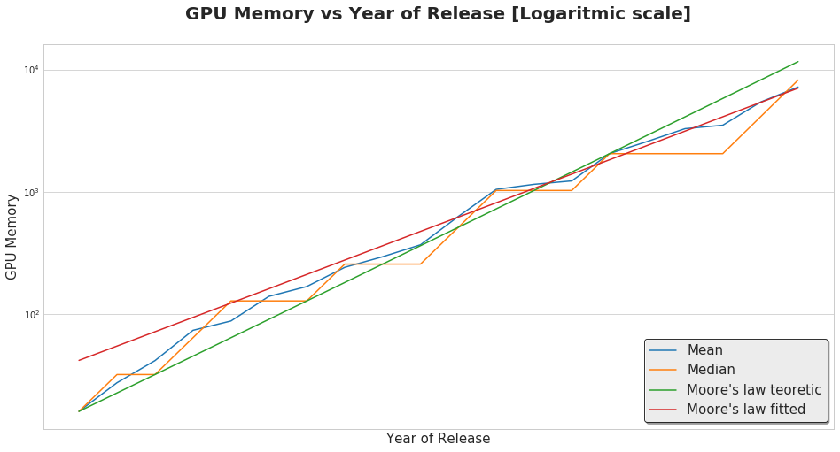
GPUs memory tends to follow Moors law but not exactly
Created a RED fitted line to fit the dataset better
Notes:
We can see that the mean size of the GPUs memory tends to follow Moors law curve but not quite exactly. I used curve_fit to create a second curve from the same family (red line) that fits the dataset better.

Slide 9
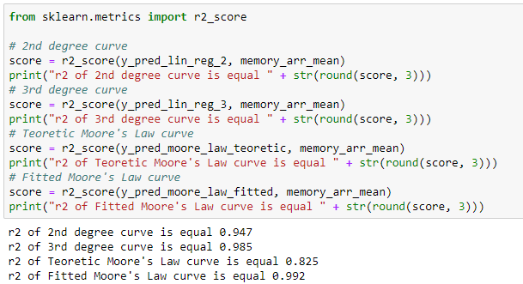
Polynomial regression
Notes:
I used the Polynomial regression prediction model from sklearn and fitted it to the dataset. I then selected the best model against the moors law curve and got the following results:

Slide 10
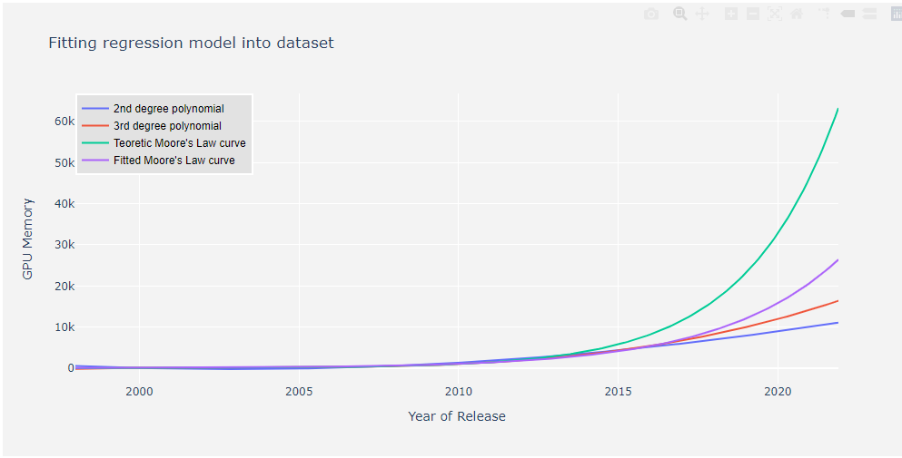
Moors law curve for predicting the GPUs
Notes:
Based on the r2 scores I selected the Fitted moors law curve for predicting the GPUs mean memory size.

Slide 11
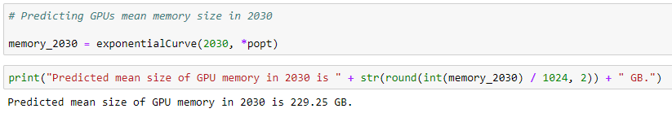
Predict GPU size in 2030
Notes:
In conclusion I can say I was wrong to think that GPU performance over time was the result of competition in the GPU market and was Moors law that was the main driver in the increased performance seen over the last 10 years. The competition between the two main companies in the GPU market, Nvidia and AMD, was actually the price not performance. The competition did not bring performance, but it did make GPUs more affordable for consumers. The main difference here is that the technology has changed in the GPU market but the raw memory of GPUs cannot escape Moors law so in essence GPUs in the future will see higher memory size but the technology of how to put pixels on your screen will change to be more efficient and that is where the GPU market competition will increase. I was surprised to see the predicted size for memory in 2030 be 229 GB that seems so large for todays standards however if I look back to the GPU sizes from 2010, I should not be as surprised.
Some lingering questions on my kind after this project
Could I have also predicted transistor size?
Where there any other parameters that were better suited for this analysis than GPU memory size?

